Slide 1

Keeping Children Safe in a Technological
World.
November 2023

Slide 2
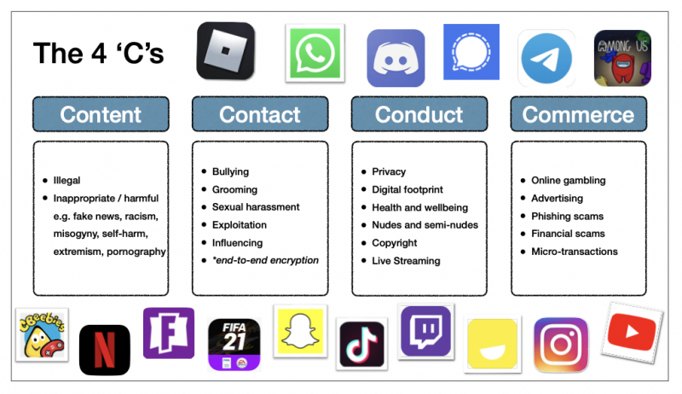

Slide 3
2023 Y4-6 Internet and Social Media Survey

Slide 4
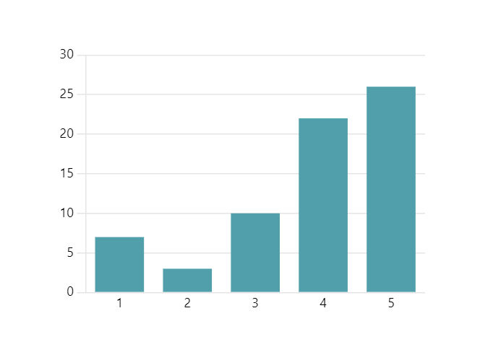
How confident are children about keeping safe online?

Slide 5
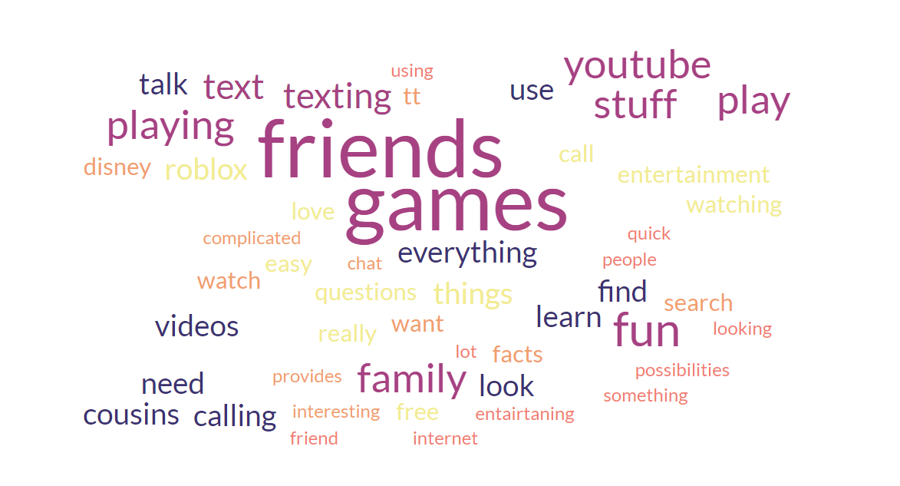
What do Cherry Hinton children like about the internet?
25% mentioned games
24% mentioned communicating with friends and family
15% mentioned learning or finding out things

Slide 6
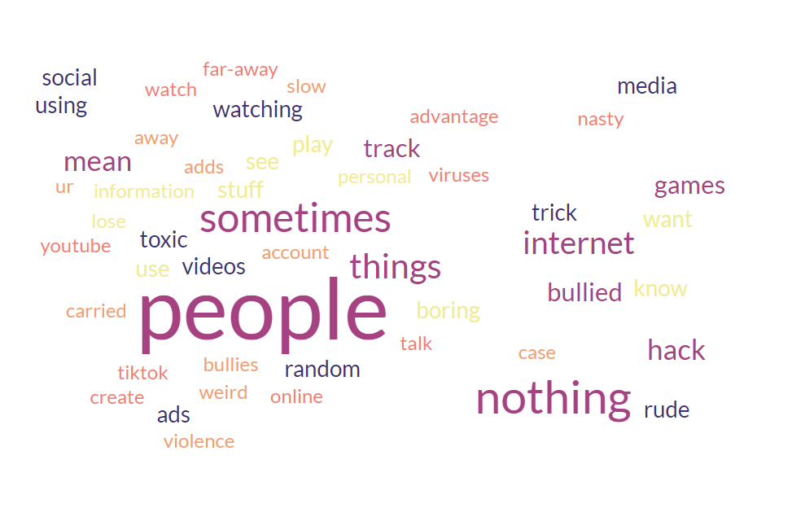
What do Cherry Hinton children dislike about the internet?
29% mentioned negative interactions
13% mentioned concerns about hacking/sharing of personal information
7% mentioned inappropriate content

Slide 7
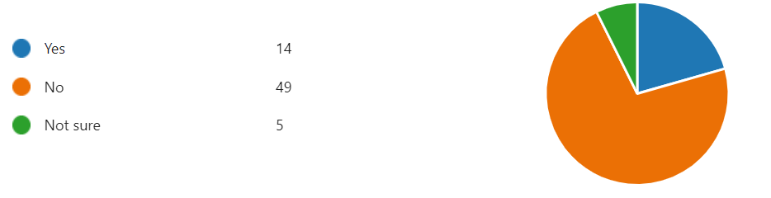
Have you ever been bullied online?

Slide 8
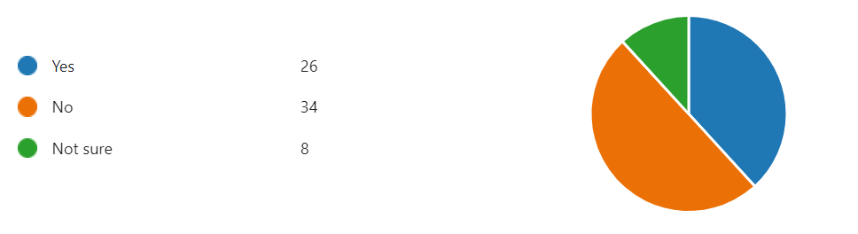
Have you ever witnessed bullying online?

Slide 9
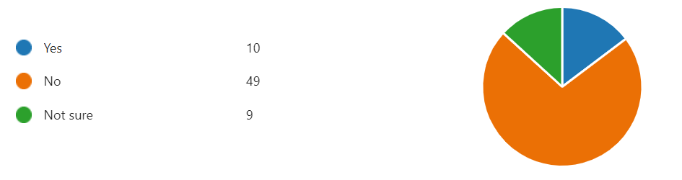
Have you ever been unkind online?

Slide 10
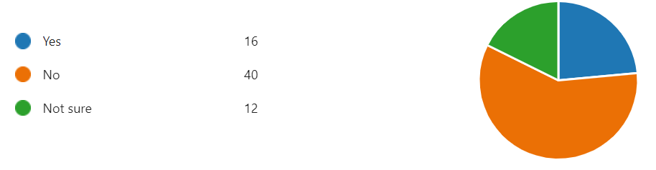
Have you ever seen something that made you uncomfortable?
These included: bullying, racism, hacking, threats, inappropriate content, photo sharing

Slide 11
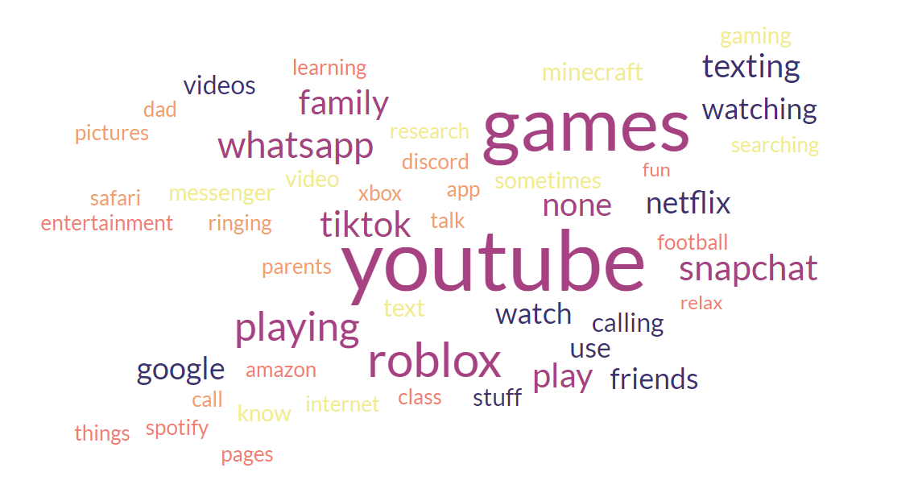
What do Cherry Hinton children use the internet for?
62% mentioned YouTube
28% mentioned Roblox
16% mentioned TikTok
https://theictservice.onlinesafetyhub.uk/

Slide 12
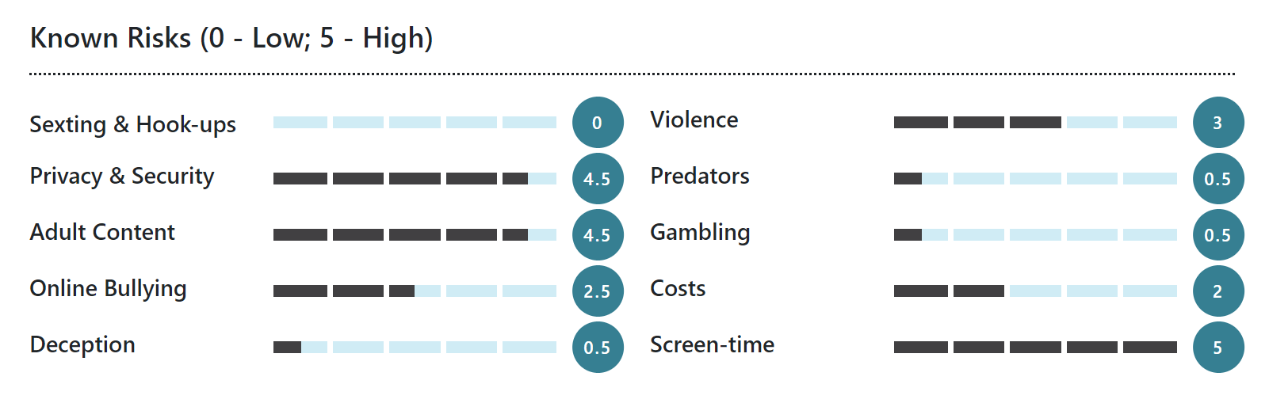
YouTube is the world's most popular video-streaming app. This app is fairly simple; post and watch videos. The content of YouTube videos is extensive, and can be related to anything from skateboarding to music videos, tutorials for makeup to instructional videos for sex or drug-taking, violent gaming or blatant pornography. Furthermore, it is important to note that YouTube comments are notoriously nasty, so it is wise to encourage your children not to engage with other people in the comments section of the videos.
YouTube can be used as a great learning tool and has a lot of interesting information, so turning on YouTube's built-in filtering (called YouTube Restricted Mode) and regular monitoring, will make the app safer for kids to use. With filters turned on, our experts recommend this app be used by young people 10 and up. YouTube for kids is a great alternative for younger kids.

Slide 13
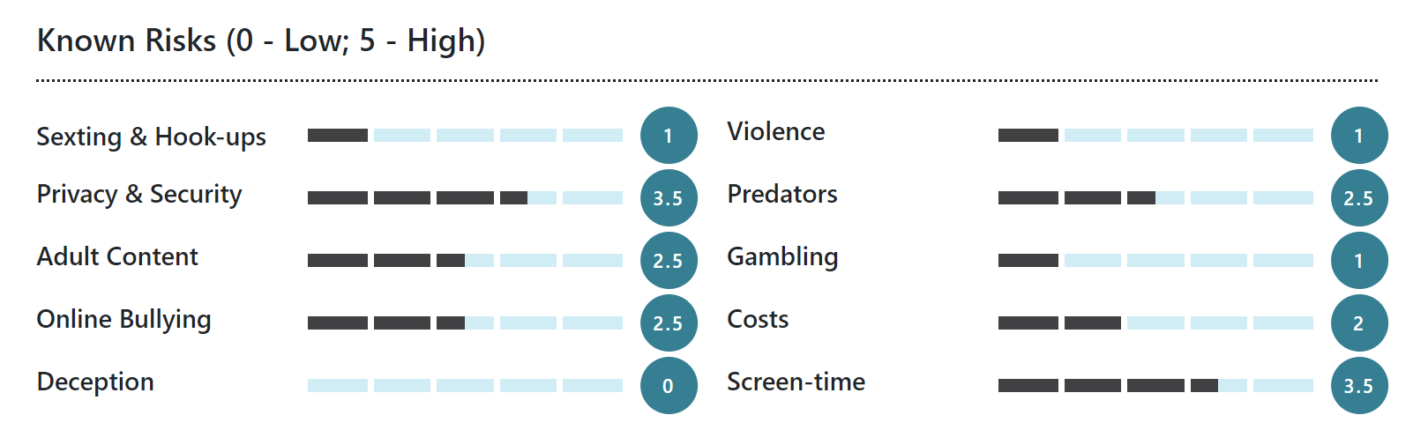
Roblox is a large, popular online gaming platform where users create and share their own virtual 3D worlds or use their avatar to play games and interact in worlds designed by other users. Game designs and objectives are limited only by user imagination (and their coding abilities), and include anything from shooter-style or fighting games to sports, murder mysteries, or virtual pet care.
Although the cartoon block-style graphics make Roblox appear to be child-like, it is a highly interactive, multi-player global platform where users of all ages can connect and chat via voice or text. Many parents don't actively supervise their children when they are playing Roblox or ensure the game's safety settings are enabled, and consequently, there have been some incidents of online grooming and children encountering inappropriate content on the platform.
Our online safety experts recommend Roblox for players aged 13 years or over; however, with appropriate online safety settings and supervision in place, this game can be suitable for children from 11 years of age.

Slide 14
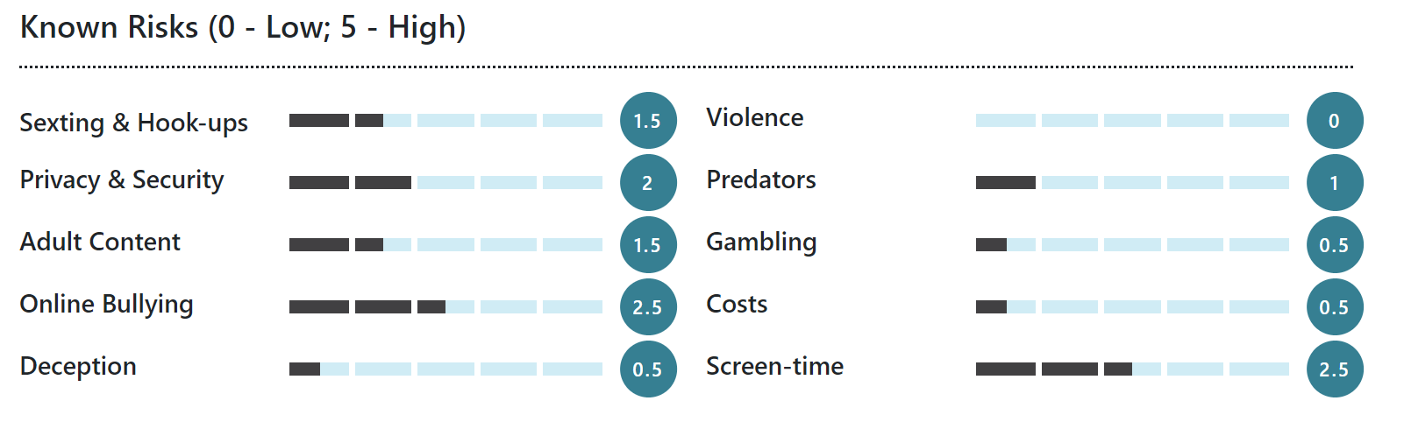
WhatsApp is a hugely popular messaging app owned by Meta (formerly Facebook), and used by over 2 billion people worldwide. Children and teens use WhatsApp to send text messages to friends, participate in group conversations (a particularly popular feature), make calls, and send multimedia files such as pictures, videos and voice messages.
Users connect through a phone number or email address, and can use the application on their smartphone as well as on their desktop. The app is free to use (although data charges may apply) and runs off a stable WiFi connection or data. It is considered one of the safest messaging platforms around, given its use of end-to-end encryption (a data-protection measure that ensures only the sender and receiver can access the content within a message).
Disappearing messages are another popular feature adopted from Instagram and Snapchat. Other features include enabling users to share their live location, ‘broadcast’ a single message to multiple individual contacts at once, hide when they were last active inside the app, and add people to a group chat despite not being a saved contact.

Slide 15
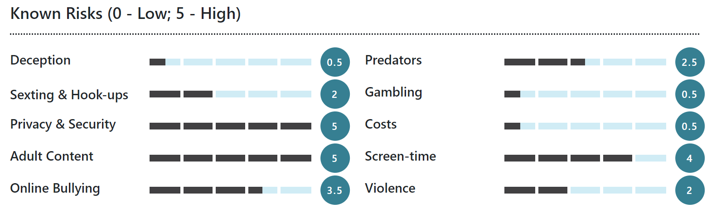
TikTok is a social media platform where users create, share, and view an endless stream of short-form videos. It hosts content of almost any topic, and although most parents are likely familiar with TikTok’s viral dance trends and lip syncing challenges, they may be unaware that inappropriate content is rife on the platform. Even without performing a specific search, users can easily come across videos that feature profanity, drug use, discussions about self-harm and other serious mental health issues, and sexually explicit content.
Although the platform’s terms of service state that users must be 13 years or over, the birth date they are required to enter when setting up an account is not verified, making the platform easily accessible by those who are underage. Due to the nature of the content that can be found on TikTok, the amount of data the platform collects, and the volume of personalised content its unique algorithm provides, we have given it a higher age recommendation (15+) than that of the platform or the App Store.

Slide 16
In the digital world, finding the right screen time is a major concern for most parents and carers. Here is what to consider…
In a recent report 66% of parents believe parenting is more difficult than 20 years ago with most suggesting technology as the reason.

Slide 17
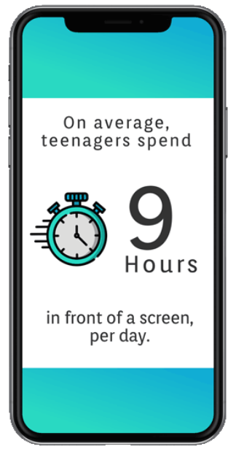
How much suggested screen time for each age range? (World Health Organisation)
2 years and under o hours
2-4 years less than 1 hour per day
5-17years A MAXIMUM OF 2 HOURS PER DAY RECREATIONAL SCREEN TIME (INCLUDING MESSAGING, T.V. VIEWING, GAMING)

Slide 18
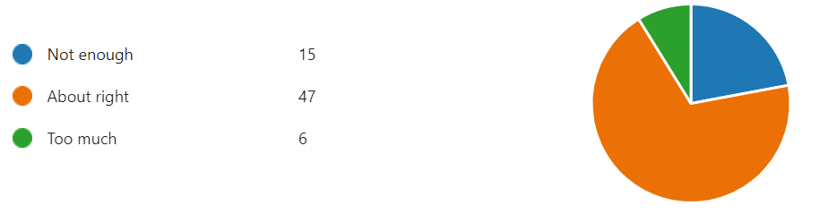
Screen Time at Cherry Hinton

Slide 19
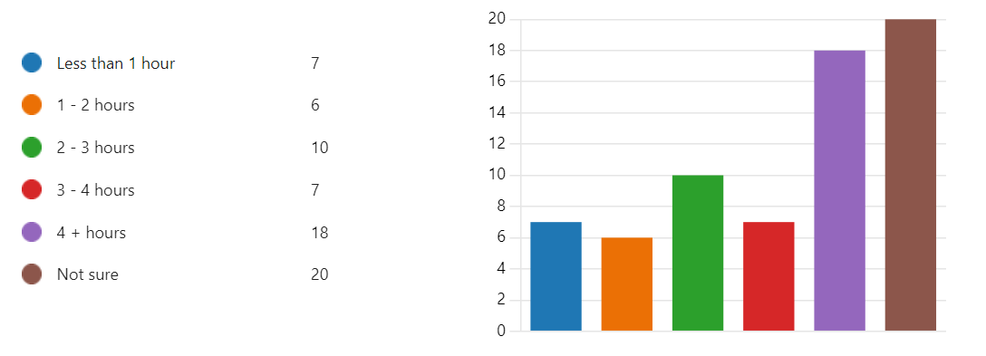
Screen Time at Cherry Hinton

Slide 20
At what age are children most vulnerable online?
Several groups are vulnerable to device use. Research has shown that:
Parents and carers of toddlers and pre-schoolers provide unsupervised access to screentime.
Children are commonly given their first personal device before they enter secondary school. The difficulty in managing screen time without parental supervision therefore increases.
Teenagers display the highest level of screen use. One of the greatest concerns with this age bracket is the impact of late night device use on sleep quality.
A lack of screen time limits and healthy boundaries around where and for how long screen time is happening can lead to excessive screen use by children and teenagers.
Unsupervised access to devices increases the likelihood of screen time issues and exposure to inappropriate online content.

Slide 21
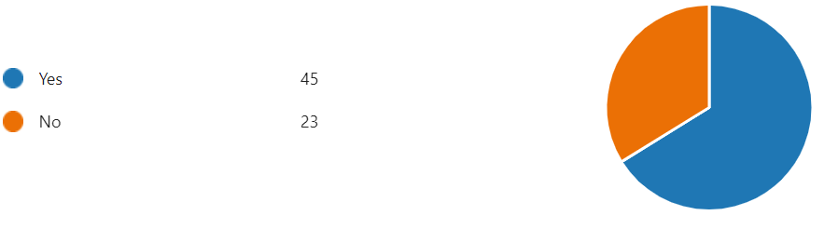
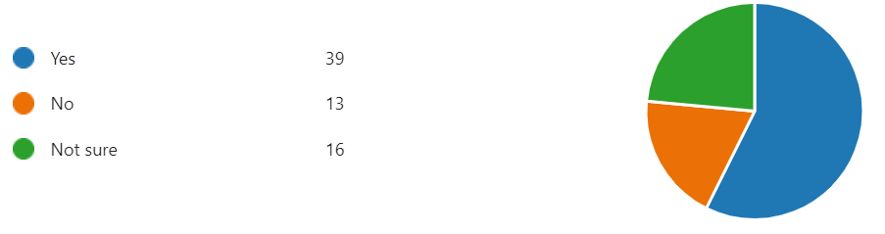
Device Supervision
Do you use devices without an adult around?
Do your parents/carers know everything you use devices for?

Slide 22
What can you do? Advice from an expert…
Get involved in screen time activities.
Quality over quantity.
Find a balance
Stay aware of the type of activities your child is participating in so you can make informed choices about screen time limits.
Anything that has more quality e.g. educational video or watching a family movie can render more quality or time.
Cartoons may be fun but don’t provide much in the way of educational value. Watching a small amount doesn’t do any harm but won’t do their brain any favours!
Physical activity
Adequate sleep
Social interaction
Hands- on outdoor activities
Face to face interaction
Balance with
Moderate screen time
Using technology with your children is a great way to understand what they are doing.
Co-viewing has many benefits by reducing the negative effects of screen time.

