Slide 1


Reading Meeting 2024
Thank you for coming today!
OFSTED JUNE 2023
“Love of reading is a priority for this school.
Staff teach phonics well.
Pupils who need support with reading receive extra help.
Pupils quickly become fluent readers.
Pupils enjoy the daily stories read to them by adults.”

Slide 2
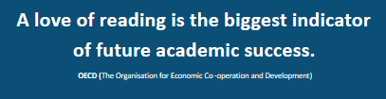
Our aims for reading
Inquisitive thinkers; Inspired learners; Kind hearts
Lifelong love of reading for learning or pleasure.
Skills to access any materials throughout school and beyond.

Slide 3

Phonics
In school we teach children phonics as a first approach.
What is phonics?
- the sounding out and blending of sounds.
cat hat

Slide 4
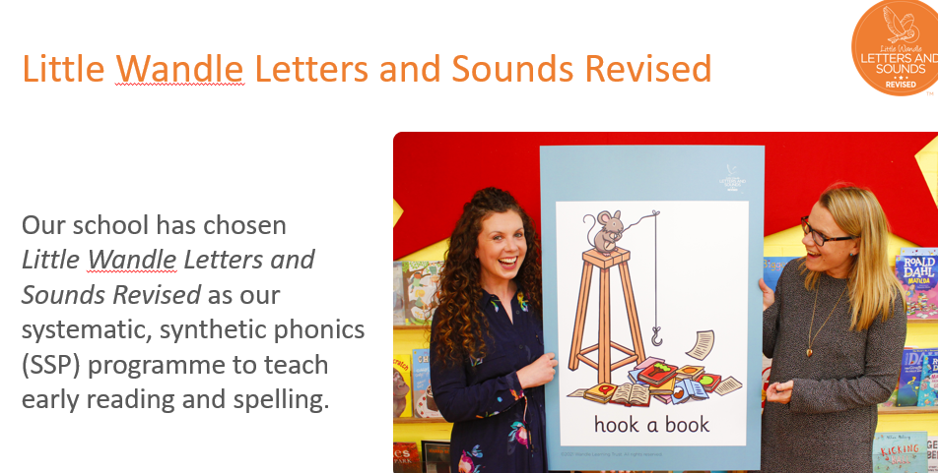

Slide 5
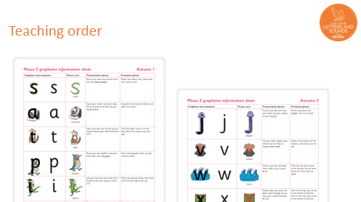
After these initial sounds, the children progress on to
digraphs e.g
Sh- shell ch-chip ai-train

Slide 6
We will tell you which phonemes the children have learnt each week and we ask you to practise them at home. (show phonics sheet)
Simple I say you say game is very effective when looking at the sound.
Robot talking- Pass me the j..a..m please.
(to practise oral blending)
Post it notes around the house and referring to them little and often really helps.

Slide 7
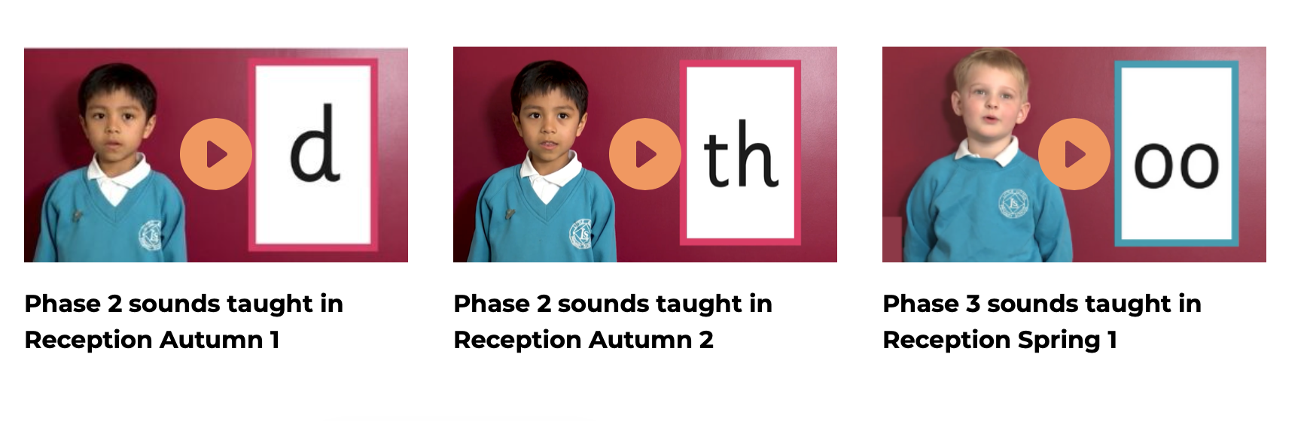
Supporting your child with phonics
Notes:
It is really important that you pronounce the sounds correctly at home if you are supporting your child. These videos are on the website for you to refer to and if you are unsure, please ask your child’s teacher.
Show the parents where to access the videos on the website and play them!
https://www.littlewandlelettersandsounds.org.uk/resources/for-parents/

Slide 8
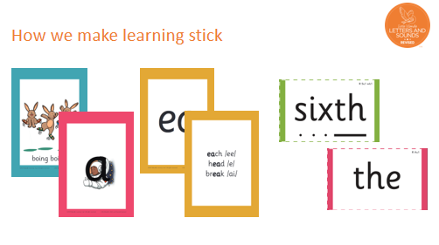
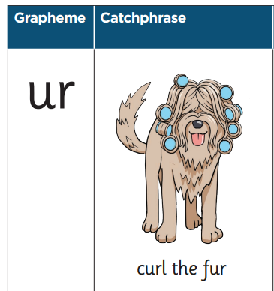
Notes:
There are specific resources for the Little Wandle Programme which the children will be very familiar with. Each sound that we teach to begin with has either a mnemonic (like the astronaut that you can see here) or a phrase like boing-boing for ‘oi’. This helps the children recognise and remember the graphemes. Every time we teach a new sound, we also read words during the phonics lesson that contain that new sound so that the children practise what they have learned. We then go on to reading a sentence containing some of those words. We have displays in the classroom and on the tables to support the children throughout the day.

Slide 9
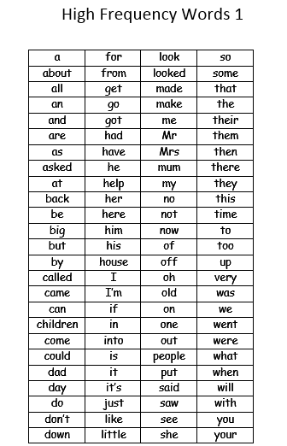
Tricky words
When teaching reading, we focus on phonics, but if your child knows their tricky words it will aid their fluency.

Slide 10
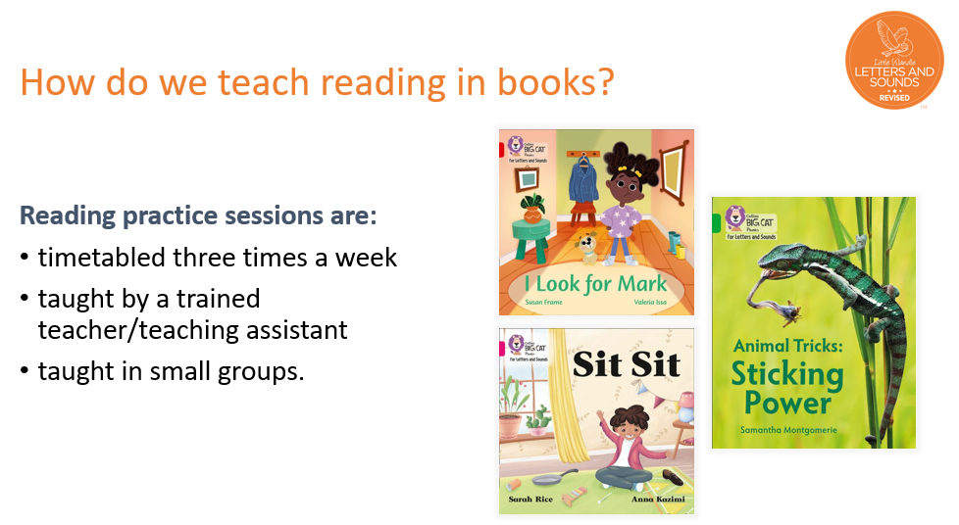
https://primaryteacher.collinshub.co.uk/educator.html?s=qh2ZmR2XwgTM2QzXzFGcvlWd5RncldXc#course_
library&service=FederatedRhapsode&service_name=Collins%20Big%20Cat&content_type=package&content
_id=16504&simulate_module=true

Slide 11

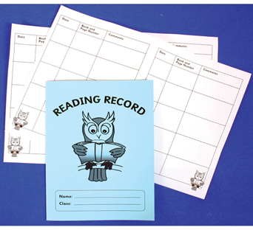
Reading at home
Research shows that re-reading the same book really helps children to make rapid progress.
Each week your child will have
1. One fully decodable e-book assigned per week on the Big Cat Collins website. We will give you your log-in details today
This book has been matched at the right level which means that your child should:
Know all the sounds and tricky words in their phonics book well
Read many of the words by silent blending (in their head) – their reading will be automatic
Only need to stop and sound out a few of the words– but they should be able to do this on their own.
In the week beginning 16th September you will receive a reading record for your child.

Slide 12

The most important thing you can do is read with your child
2. Another book which is for pleasure and for sharing.
Research shows that reading a book and chatting about it has a positive impact on children’s ability to read even years late in the following areas…
understanding words and sentences
using a wide range of vocabulary
develop listening comprehension skills.
The amount of books children were exposed to by age 6 was a positive predictor of their reading ability two years later, and of their educational outcomes at age 16.
Parental involvement in the development of children’s reading skills: A five-year longitudinal study (2002) Senechal, M. and Lefvre, J
Notes:
Celebrate child’s success at school, make time for reading at home!

Slide 13


Take Home Today
Login information for Collins online app where you can access a decodable book for your child to read. At first this will be a wordless book that is great for chatting about and getting used to the routine of reading Collins online every week.
Each week the class teacher puts a new book online (on a Friday) for you to listen to your child read. The teacher can check how much they have read their online Collins book with you at home. We will be celebrating with children when they have read their online book with you.
In Your Child’s Bookbag
(available from school office from 16th September)
A school library book for you to read to them and enjoy together
(changed weekly).
A reading record for teachers and parents comments.

Slide 14

How can you help at home?
Be a good role model- let them see you read and the purpose of it.
Listen to them read the ebook.
Read a bedtime story – this is so enjoyable and allows them to learn about the structure of stories and language. ( in any language)
Read signs when you are out and about:
Keep off the grass
Car park
Visit the library it’s a mobile one at the moment– you can borrow 12 books free!!!!

Slide 15
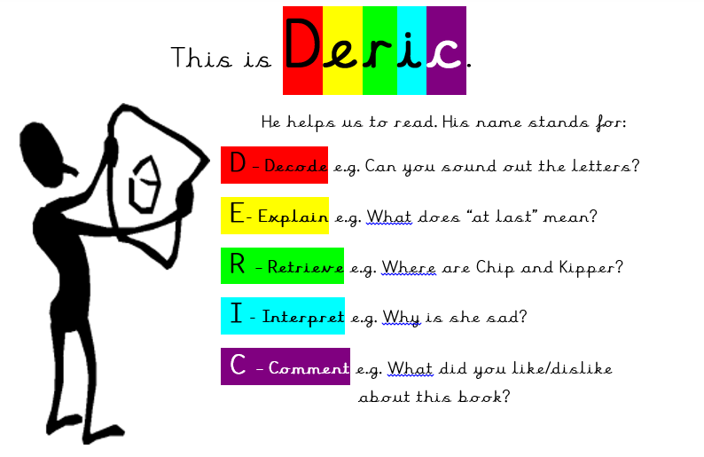
Word recognition (decoding) and comprehension (understanding )are both necessary to be a good reader. It is important to talk about what has been read so that children understand and enjoy the story.
As your children are learning to read, we are constantly showing them that reading is fun and purposeful.

Slide 16
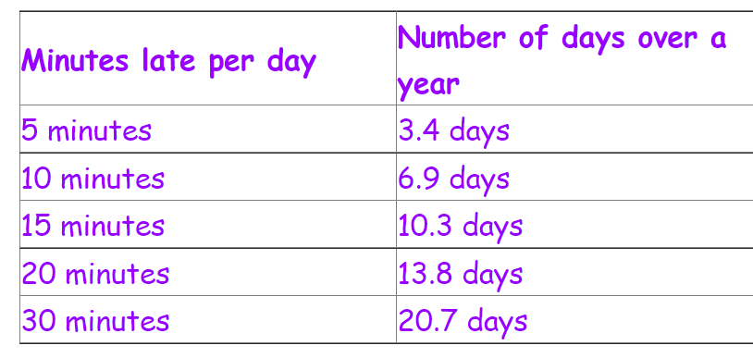
School gates open at 8:45am
Lateness can really affect how your child settles into the school day.

Slide 17
Any questions?

Slide 18
